Slide 1

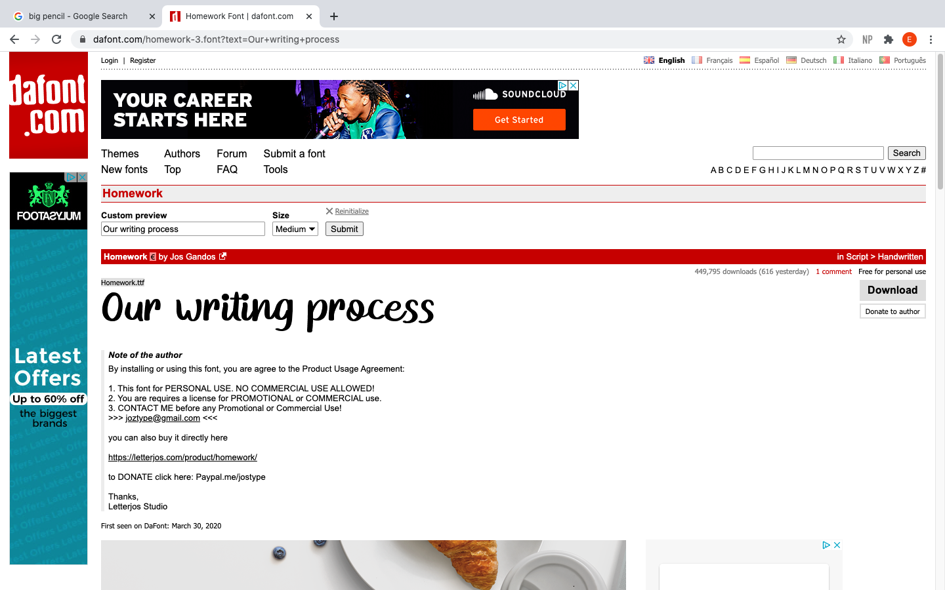
EDIT
Go through with editing pen, check spelling and grammar and correct these.
PLAN
Brainstorm and organise our ideas using the story mountain.
PUBLISH
Sometimes we publish our work on paper.
DRAFT
Write a draft, use vocab journals to draft sentences.
WRITE
Write our piece in our books.

